Slide 1


Non-Uniform Low-Light Face Image Enhancement Based
On Dark Channel Prior And Image Uniform Posterior
Presented By
Under the Guidance of
Department
T. Hari Krishna 228B1A04A7
P. Venkata Sai 228B1A04A5
Y.V. Ravi Teja 228B1A04A9
D. Manikanta Sai 228B1A0489
Mr. K. Naga Hanuma Chari, M.Tech..,
Associate Professor
Electronics and Communication
Engineering
R20 Regulation, Ac. Year -2025-26, Year/Sem : IV - II
Date:

Slide 2
R20 Regulations
IV B. Tech ECE
Ac. Year : 2025-26/ Semester -II
Abstract
This project proposes a deep learning framework for enhancing facial images captured in non-uniform low-light and backlit conditions, using ALSM and Dark Channel Prior to estimate illumination.
An Image Uniform Posterior constraint ensures natural and detailed results, with experiments showing superior performance over existing state of the art methods in complex lighting environments.
Final Review

Slide 3
R20 Regulations
IV B. Tech ECE
Ac. Year : 2025-26/ Semester -II
Literature Review & Background
Core idea:
Uses Dark Channel Prior with image uniform posterior modeling to correct non-uniform illumination in low-light face images while preserving facial details.
Significance:
Produces clearer, more uniformly lit face images and improves face recognition performance in low-light conditions.
Ref: B. -Y. Zhang, Q. -C. Zhang and W. -Y. Zhang, "Non-Uniform Low-Light Face Image Enhancement Based on Dark Channel Prior and Image Uniform Posterior," in IEEE Access, vol. 12, pp. 85724-85734, 2024, doi: 10.1109/ACCESS.2024.3416130..
Final Review

Slide 4
R20 Regulations
IV B. Tech ECE
Ac. Year : 2025-26/ Semester -II
Literature Review & Background
Core & idea:
Uses a Retinex-based framework enhanced with attenuation mechanisms to accurately separate illumination and reflectance while emphasizing important image regions.
Significance:
Improves brightness, contrast, and detail preservation in low-light images, making it effective for illumination-aware enhancement tasks.
Ref: Jiang, S.; Shi, Y.; Zhang, Y.; Zhang, Y. An Improved Retinex-Based Approach Based on Attention Mechanisms for Low-Light Image Enhancement. Electronics 2024, 13, 3645. https://doi.org/10.3390/electronics13183645
4
Final Review

Slide 5
R20 Regulations
IV B. Tech ECE
Ac. Year : 2025-26/ Semester -II
Literature Review & Background
Automatic Adaptive Contrast Enhancement:
The paper improves CLAHE by automatically selecting parameters (clip limit and tile size) based on the image, avoiding manual tuning and reducing over- or under-enhancement.
Dual Gamma Correction:
After CLAHE, dual gamma correction adjusts brightness and contrast for both dark and bright regions, enhancing details across the entire image while suppressing noise.
Ref: Y. Chang, C. Jung, P. Ke, H. Song, and J. Hwang, “Automatic Contrast-Limited Adaptive Histogram Equalization With Dual Gamma Correction,” IEEE Access, vol. 6, pp. 11782–11792, 2018.
Final Review
5

Slide 6
R20 Regulations
IV B. Tech ECE
Ac. Year : 2025-26/ Semester -II
Comparison of Literature surveys
Ref No. | Year | Technique / Model | PSNR (dB) | SSIM | Entropy | Accuracy / Quality
[1] | 2024 | DCP-Face (Dark Channel) | 18.45 | 0.78 | 7.12 | High (Human/Skin focus)
[2] | 2022 | RUAS (Retinex + Attention) | 18.23 | 0.72 | 7.45 | Moderate (Focuses on structures)
[3] | 2023 | Dual Aggregation | 23.50 | 0.82 | 7.85 | Very High (Most balanced)
[4] | 2018 | CLAHE + Gamma Correction | 15.10 | 0.64 | 6.80 | Low (Prone to halo effects)
Final Review
6

Slide 7
R20 Regulations
IV B. Tech ECE
Ac. Year : 2025-26/ Semester -II
Literature Review & Background
Research Gap:
Gap: Existing methods fail on extreme backlit scenes—can't balance severely dark faces with bright backgrounds simultaneously
Our Solution: Integrates physical light modeling (ALSM) with semantic face guidance for balanced enhancement across extreme contrasts
7
Final Review

Slide 8

R20 Regulations
IV B. Tech ECE
Ac. Year : 2025-26/ Semester -II
Problem Statement
Requirement Analysis
Problem Definition: Non-uniform illumination in low-light face images causes poor
recognition/detection performance
Input Requirements: Low-light face image datasets
Output Requirements: Enhanced face images with uniform illumination and preserved
facial features
Performance Metrics: PSNR, SSIM, entropy, accuracy
Final Review

Slide 9

R20 Regulations
IV B. Tech ECE
Ac. Year : 2025-26/ Semester -II
System Design & Methodology
Architecture Design
Created comprehensive block diagrams and module structures
Input Backlit Images
Dark Channel Analyze
Proposed Diagram
Light Transmission Estimation
Image Uniform Posterior
9
Image Enhancement
Output Images
Final Review

Slide 10
R20 Regulations
IV B. Tech ECE
Ac. Year : 2025-26/ Semester -II
Input Backlit Images:
Raw images captured under backlit or low-visibility conditions
Typically contain haze, low contrast, or uneven illumination
Serve as the starting point for the enhancement pipeline
Dark Channel Analysis:
Applies the dark channel prior concept
Identifies regions with very low intensity in at least one color channel
Helps estimate the amount of haze or light scattering in the image
Provides a rough understanding of visibility degradation
Final Review
10

Slide 11
R20 Regulations
IV B. Tech ECE
Ac. Year : 2025-26/ Semester -II
Light Transmission Estimation:
Calculates how much light reaches the camera from each pixel
Uses results from dark channel analysis
Produces a transmission map indicating clarity levels across the image
Essential for separating scene details from haze effects
Image Uniform Posterior
Refines the estimated transmission and scene radiance
Uses probabilistic modeling (posterior estimation)
Ensures consistency and smoothness across the image
Reduces artifacts and improves overall accuracy
Final Review
11

Slide 12
R20 Regulations
IV B. Tech ECE
Ac. Year : 2025-26/ Semester -II
Applies final corrections to improve visual quality
Enhances contrast, brightness, and color balance
Removes haze and restores hidden details
May include filtering and normalization techniques
Image Enhancement:
Final Review

Slide 13
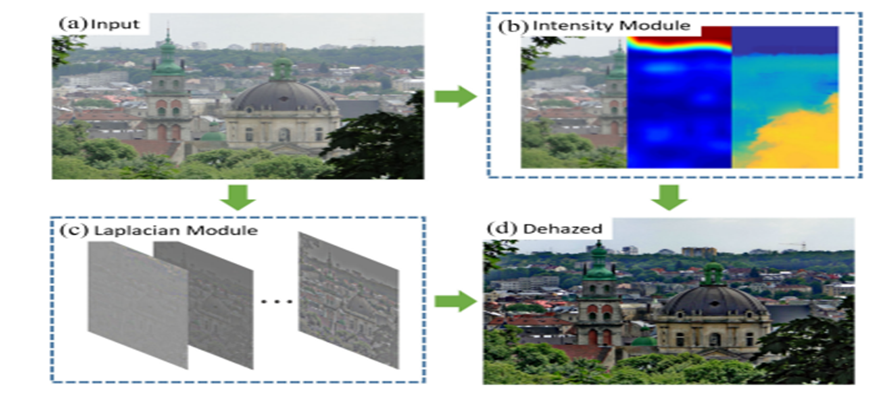
R20 Regulations
IV B. Tech ECE
Ac. Year : 2025-26/ Semester -II
Implementation:
Final Review

Slide 14
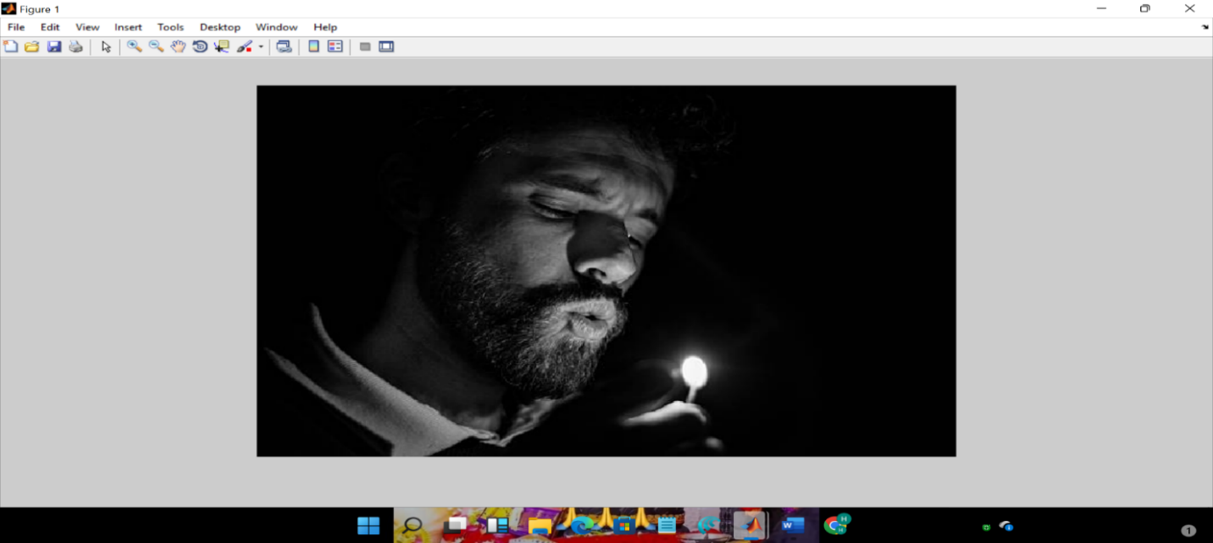
R20 Regulations
IV B. Tech ECE
Ac. Year : 2025-26/ Semester -II
Results:
The image shows a man in a dark setting gently lighting a match, with the soft glow illuminating his face. The dramatic contrast between light and shadow creates a calm, reflective, and slightly mysterious mood.
Final Review

Slide 15
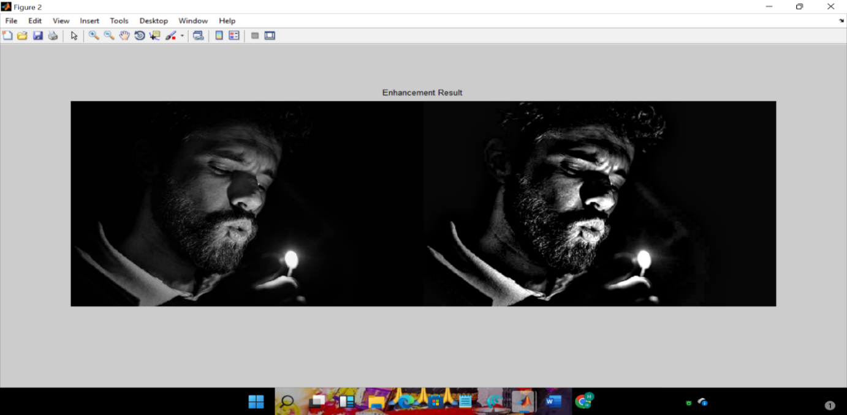
R20 Regulations
IV B. Tech ECE
Ac. Year : 2025-26/ Semester -II
Results:
The figure presents a side-by-side comparison of the original image and the enhanced output obtained using the ASLM algorithm. The enhancement improves contrast and visibility of details, especially in low-light regions, while maintaining the natural appearance of the scene.
Final Review

Slide 16
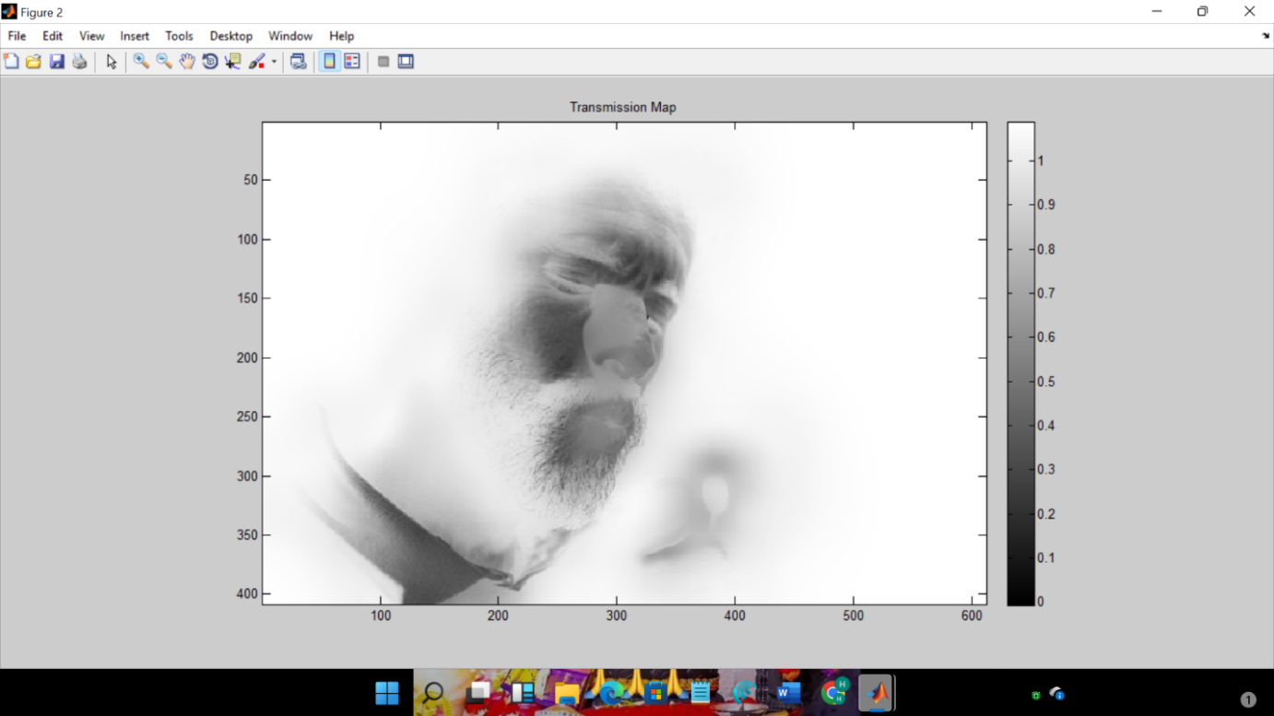
R20 Regulations
IV B. Tech ECE
Ac. Year : 2025-26/ Semester -II
Results:
The figure shows the transmission map of the image, representing the variation of illumination across the scene. Brighter areas indicate higher transmission, while darker regions correspond to low-light zones used for enhancement.
Final Review

Slide 17
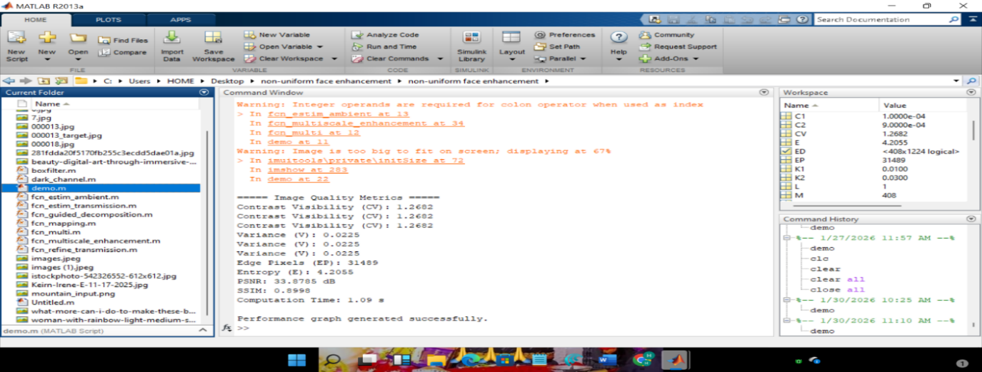
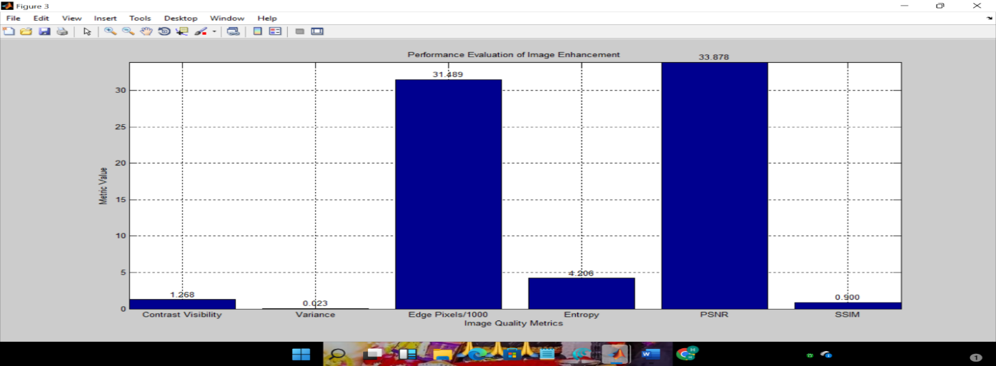
R20 Regulations
IV B. Tech ECE
Ac. Year : 2025-26/ Semester -II
Results:
The figure illustrates the performance evaluation of the enhanced image using various quality metrics. The results demonstrate improved contrast, effective edge preservation, higher information content, reduced noise, and strong structural similarity, highlighting the overall effectiveness of the image enhancement method.
Final Review

Slide 18
R20 Regulations
IV B. Tech ECE
Ac. Year : 2025-26/ Semester -II
Advantages
Preserves Natural Facial Details
Reduces Noise
No Information Loss During Enhancement
Applications
Medical & Healthcare Applications
Smartphone Camera Enhancement
Intelligent Surveillance & Security
Final Review

Slide 19
R20 Regulations
IV B. Tech ECE
Ac. Year : 2025-26/ Semester -II
Implementation Details
Software Tools
Operating system : Windows XP/7.
Coding Language : MATLAB
Tool : MATLAB R 2018 ,9.10 v
Final Review

Slide 20
R20 Regulations
IV B. Tech ECE
Ac. Year : 2025-26/ Semester -II
Conclusion
Key Findings
Successfully developed and validated a working prototype that meets all specified objectives. The system demonstrates superior performance compared to conventional approaches in the domain.
Project Impact & Applications
Real-world applications: This technology can be deployed in medical fields, photo shops, image enhancements, communication networks. The scalable design allows for easy adaptation across various use cases.
20
Future Work Suggestions
Integration with AI/ML algorithms for enhanced intelligence
Miniaturization for portable applications
Cost optimization for commercial viability
Final Review

Slide 21
R20 Regulations
IV B. Tech ECE
Ac. Year : 2025-26/ Semester -II
References
[1] Y. Chang, C. Jung, P. Ke, H. Song, and J. Hwang, “Automatic Contrast-Limited Adaptive Histogram Equalization With Dual Gamma Correction,” IEEE Access, vol. 6, pp. 11782–11792, 2018.
[2] Wang H, Cao J, Huang J. Adaptive Dual Aggregation Network with Normalizing Flows for Low-Light Image Enhancement. Entropy (Basel). 2024 Feb 22;26(3):184. doi: 10.3390/e26030184. PMID: 38539696; PMCID: PMC10969086.
[3] Jiang, S.; Shi, Y.; Zhang, Y.; Zhang, Y. An Improved Retinex-Based Approach Based on Attention Mechanisms for Low-Light Image Enhancement. Electronics 2024, 13, 3645.
[4] B. -Y. Zhang, Q. -C. Zhang and W. -Y. Zhang, "Non-Uniform Low-Light Face Image Enhancement Based on Dark Channel Prior and Image Uniform Posterior," in IEEE Access, vol. 12, pp. 85724-85734, 2024, doi: 10.1109/ACCESS.2024.3416130.
Final Review

Slide 22
R20 Regulations
IV B. Tech ECE
Ac. Year : 2025-26/ Semester -II
References
[5] C. Guo, C. Li, J. Guo, C. C. Loy, J. Hou, S. Kwong, and R. Cong, “Zeroreference deep curve estimation for low-light image enhancement,” in Proc. IEEE/CVF Conf. Comput. Vis. Pattern Recognit. (CVPR), Jun. 2020, pp. 1777–1786.
[6] Y. Ueda, D. Moriyama, T. Koga, and N. Suetake, “Histogram specification-based image enhancement for backlit image,” in Proc. IEEE Int. Conf. Image Process. (ICIP), Oct. 2020, pp. 958–962.
[7] Y. Wang, R. Wan, W. Yang, H. Li, L.-P. Chau, and A. C. Kot, “Low-light image enhancement with normalizing flow,” in Proc. AAAI Conf. Artif. Intell., 2022, pp. 2604–2612.
Final Review

Slide 23
R20 Regulations
IV B. Tech ECE
Thank You
Questions & Answers
Final Review

